Slide 1
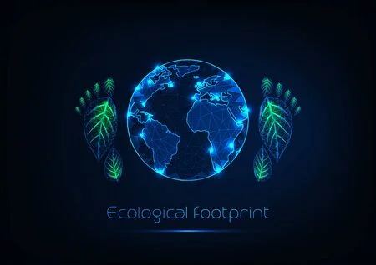


SMART INDIA HACKATHON 2022
Problem Statement Title: Develop proof of concept to measure carbon footprint of various tourism activities
Ministry Category: Software
Problem Code: PK1026
Current AICTE Application No.: SIH2022-S/W-39
Team Name: Hackcrew
Team Leader Name: Yash Raj Arora
Problem statement : Develop proof of concept to measure carbon footprint of various tourism activities
Problem description : Most tourism-related activities require energy directly in the form of fossil fuels or indirectly in the form of electricity often generated from petroleum, coal or gas. This consumption leads to the emission of greenhouse gases, mainly carbon dioxide. Tourism is not a traditional sector in the System of National Accounts and as a result no country possesses comprehensive national statistics on the energy demand or emissions specifically resulting from tourism. But tourism activity can leave behind a massive amount of carbon footprint. This carbon emissions come from transport, hotels, exploring activities and various other methods where there is a need to move around and explore new places. Hence all activities in tourism sector can be considered to be affecting the climate. We need you to develop a proof of concept which can measure the carbon footprint of various activities and provide a detailed statistical data of the entire model.

Slide 2




What is Carbon Footprint?
A carbon footprint is the total greenhouse gas (GHG) emissions caused by an individual, event, organization, service, place or product, expressed as carbon dioxide equivalent (CO₂). Greenhouse gases, including the carbon-containing gases carbon dioxide and methane, can be emitted through the burning of fossil fuels, land clearance and the production and consumption of food, manufactured goods, materials, wood, roads, buildings, transportation and other services. In most cases, the total carbon footprint cannot be calculated exactly because of inadequate knowledge of data about the complex interactions between contributing processes, including the influence of natural processes that store or release carbon dioxide.

Slide 3

Causes
TRANSPORTATION
Transportation emissions often make up the largest portion of our individual carbon footprints.
Food
Food's carbon footprint, or foodprint, is the greenhouse gas emissions produced by growing, rearing, farming, processing, transporting, storing, cooking and disposing of the food you eat.
Lodging
In the field of the tourism, hotels and homestay facilities account for considerable amounts of energy consumption and CO2 emissions.

Slide 4
Smart Electric Cars
Smart vehicles adapt to our lifestyle while meeting new environmental needs.
Packing light
Reducing the weight of the baggage could help reduce the amount of fuel needed for flights.
Travel Like A Local
Providing alternative transportation choices, which allows travelers to enjoy the experience of travelling like a local.
Ways to reduce
Carbon Footprints
Don’t Idle
Reducing idling, saves money on fuel and reduces greenhouse gas emissions.
Drive Less
Fewer miles driven means fewer emissions.
Choose Fuel Efficient Vehicles
Look for fuel efficient vehicles with low greenhouse gas emissions.

Slide 5
Calculator
Principle- To calculate the no of trees to be planted balance the carbon emission by a vehicle in1 year.
Mileage of vehicle = X
Distance travel in 1 year = Y
Formula = ( Y /X)*2680gram= Z gram/year
No. of trees =0.006*Z
NOTE: (A) 1 Litre of fuel corresponds to 2680grams of CO2.
(B) 6 trees are required to balance 1000kg of CO2.

